Slide 1

ONLINE BANKING SYSTEM

Slide 2
Team members
Hemasai Bonda
Karthikeya Ganti
Mahesh Ellapu
Sathvika Kota
Taraka Lakshmi

Slide 3
rOLES
Hemasai Bonda - DATABASE
Karthikeya Ganti – CODING
Taraka Lakshmi - CODING
Mahesh Ellapu – UI/UX
Sathvika Kota – UI/UX

Slide 4
ABSTRACT
This Online Banking System enables users to manage their accounts digitally—checking balances, transferring funds, and viewing statements. It replaces traditional in-person banking with a user-friendly interface, real-time customer support, and transparent transaction details for a better banking experience.

Slide 5
oBJECTIVES
Automate core banking operations like account creation, fund transfers, and password management.
Enhance customer experience through a user-friendly and intuitive web interface.
Enable secure access to banking services via authentication and OTP-based recovery.
Provide real-time customer support and maintain transparency in transaction charges.
Streamline admin tasks such as account approval and user management.

Slide 6
PROJECT OUTPUTS
Keeping your audience engaged through effective techniques

Slide 7
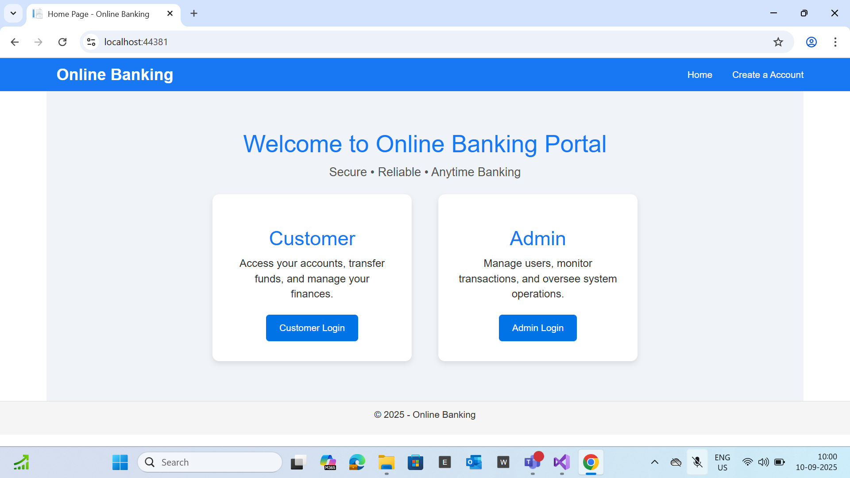

Slide 8
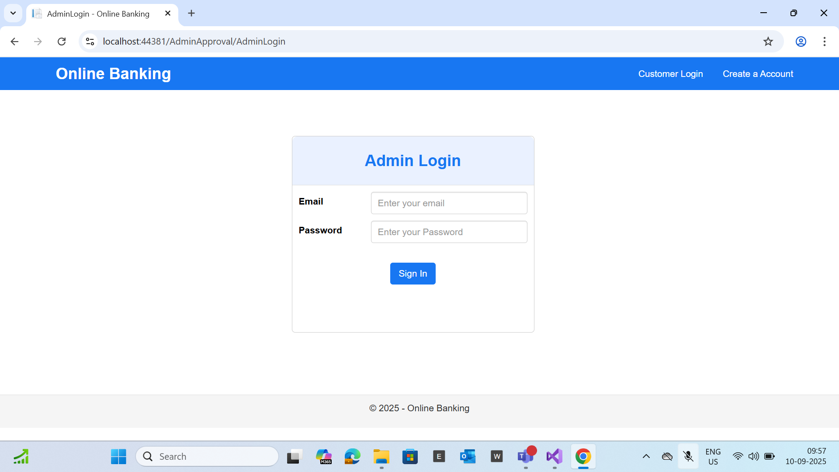

Slide 9
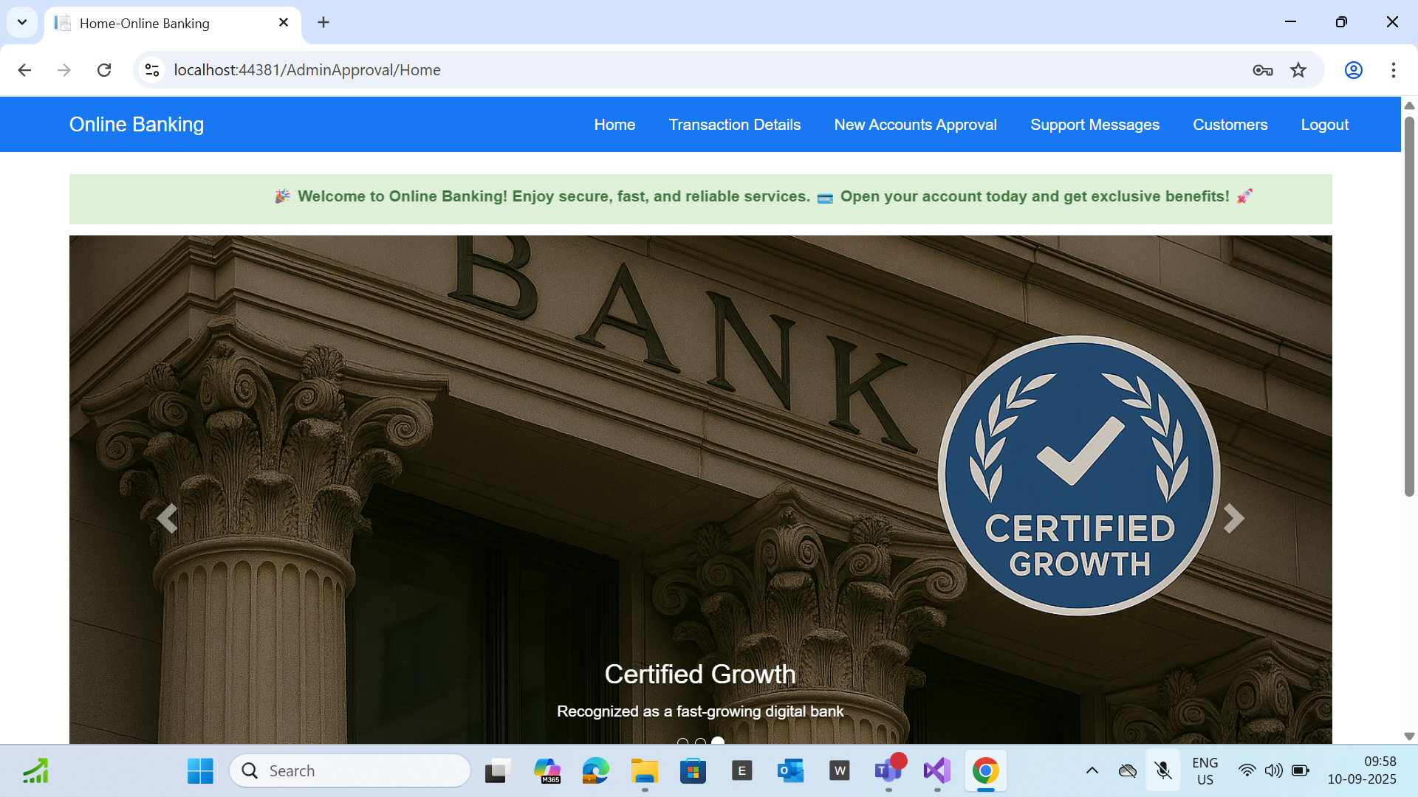

Slide 10
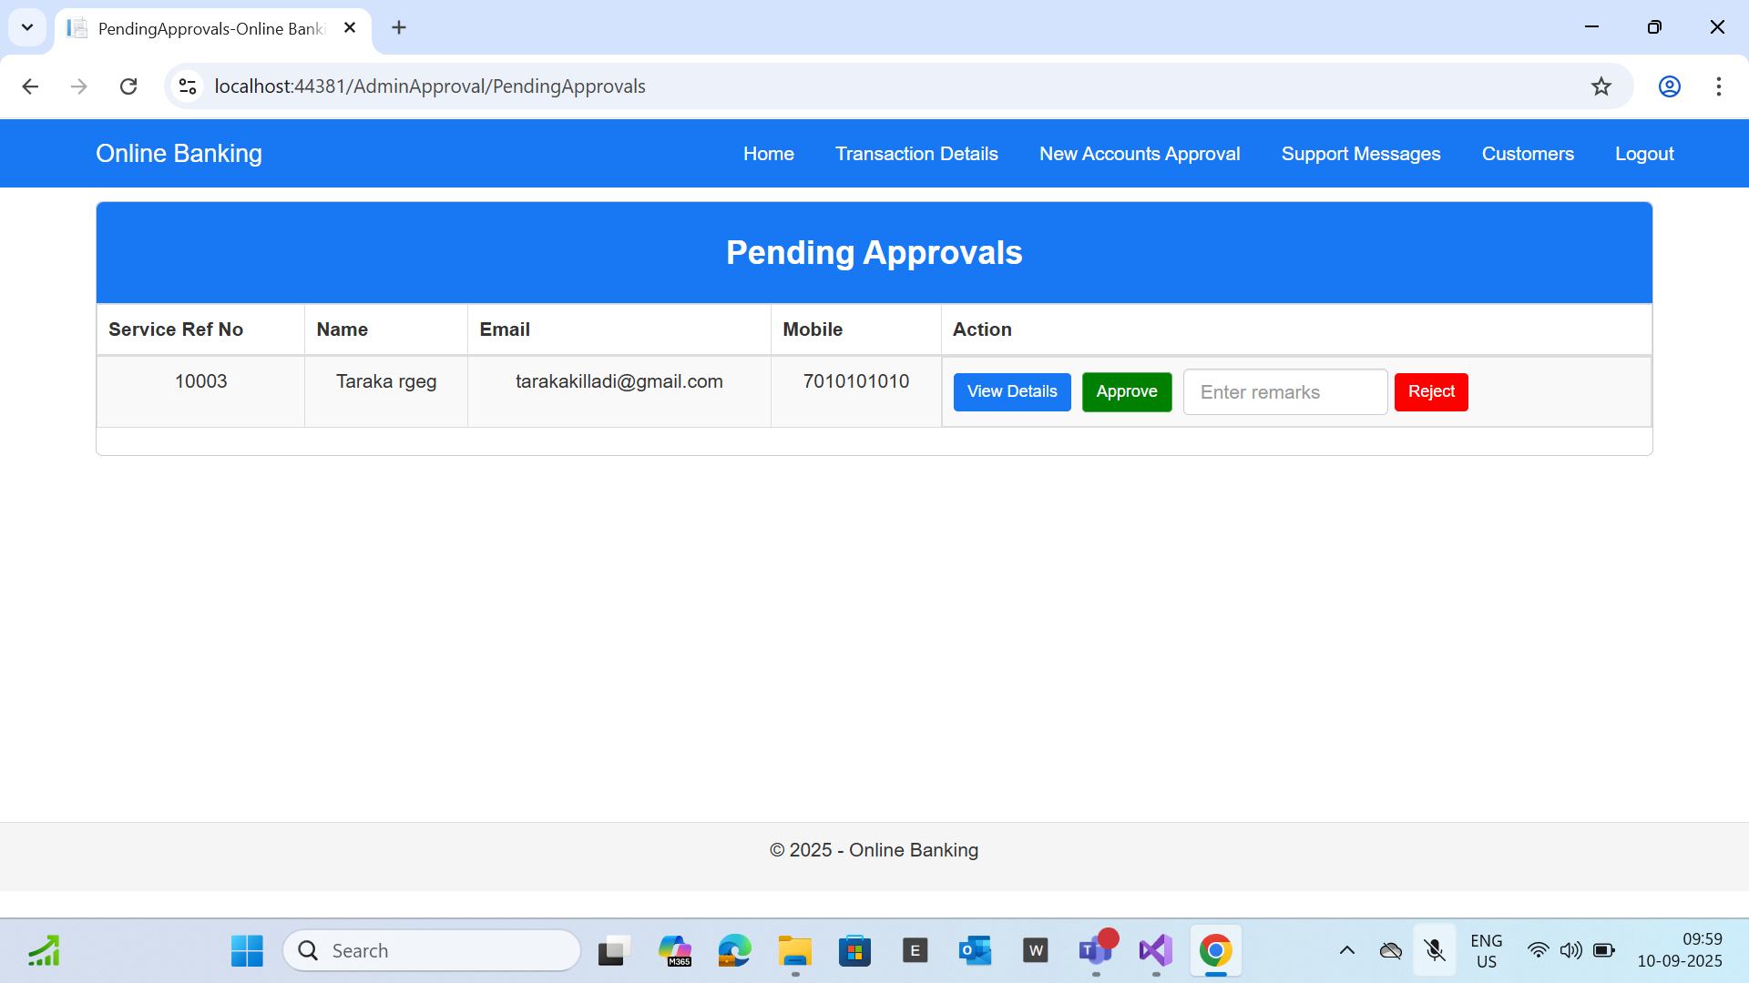

Slide 11
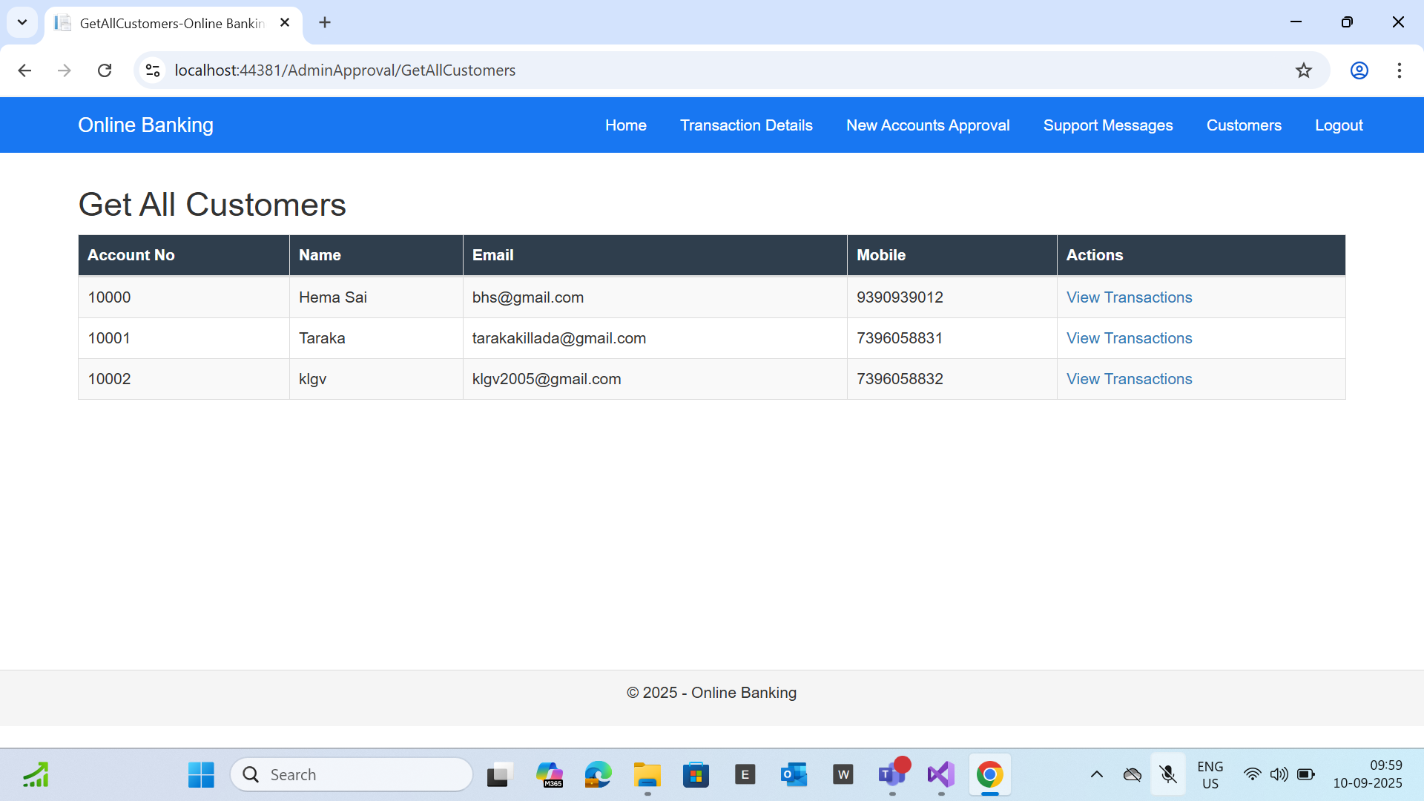

Slide 12
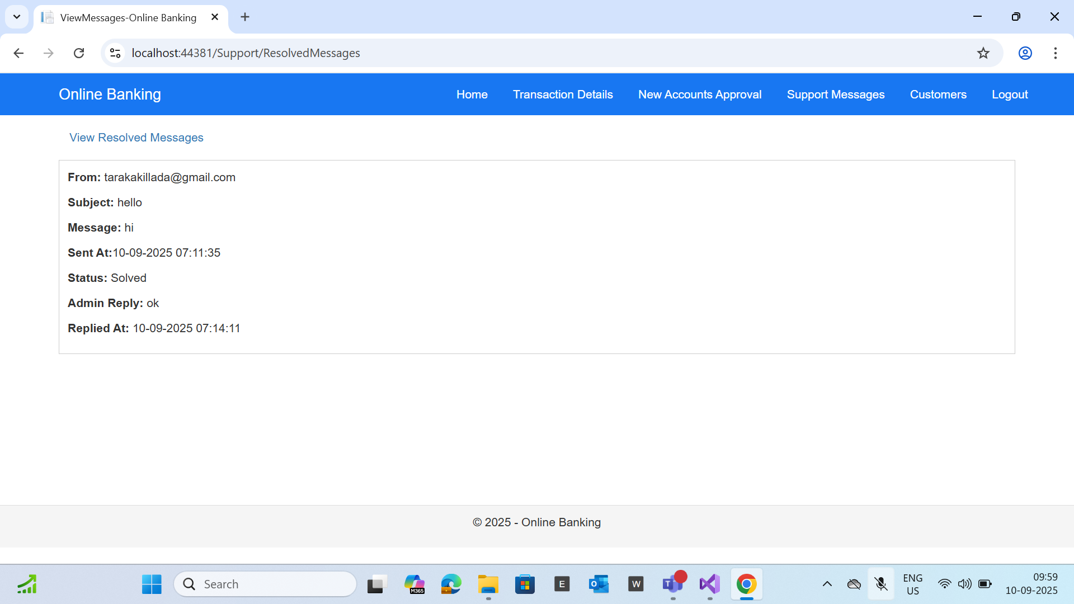

Slide 13
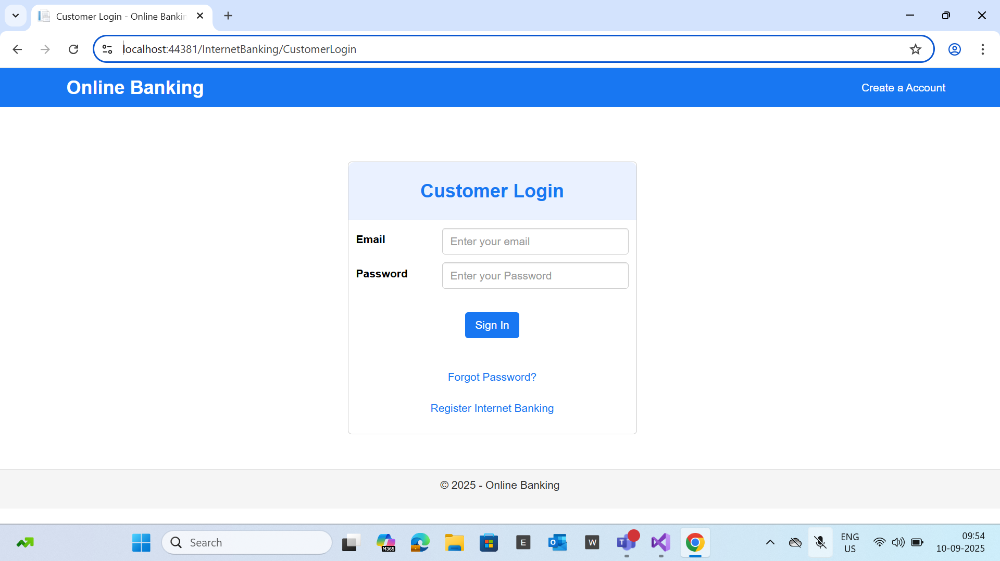

Slide 14
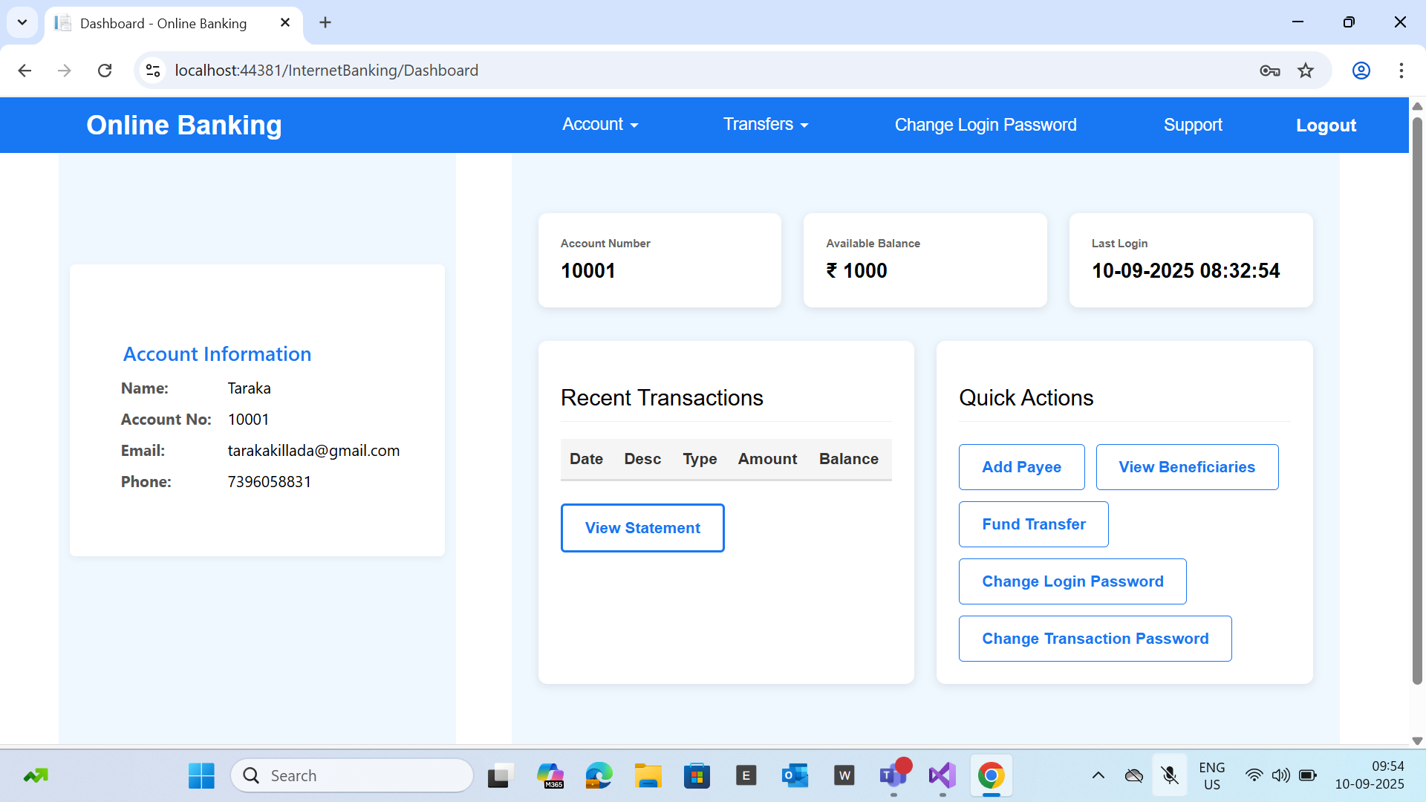

Slide 15
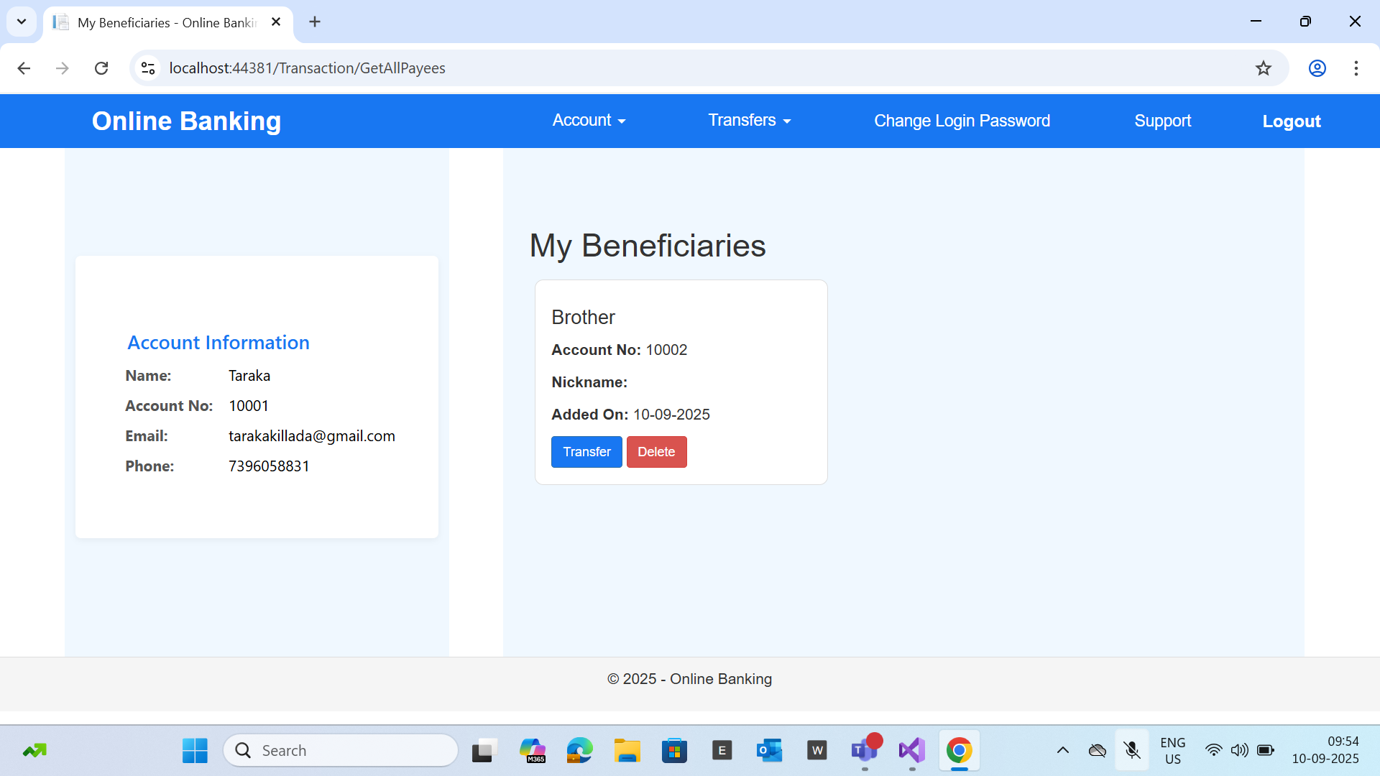

Slide 16
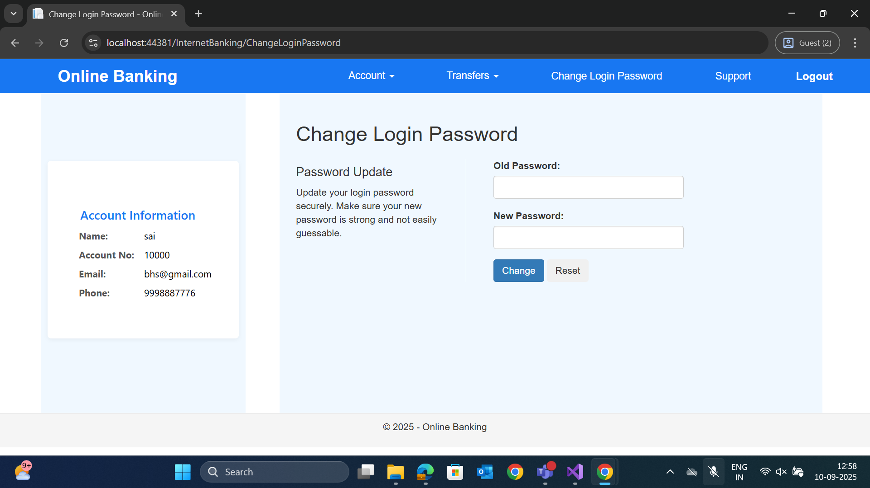

Slide 17
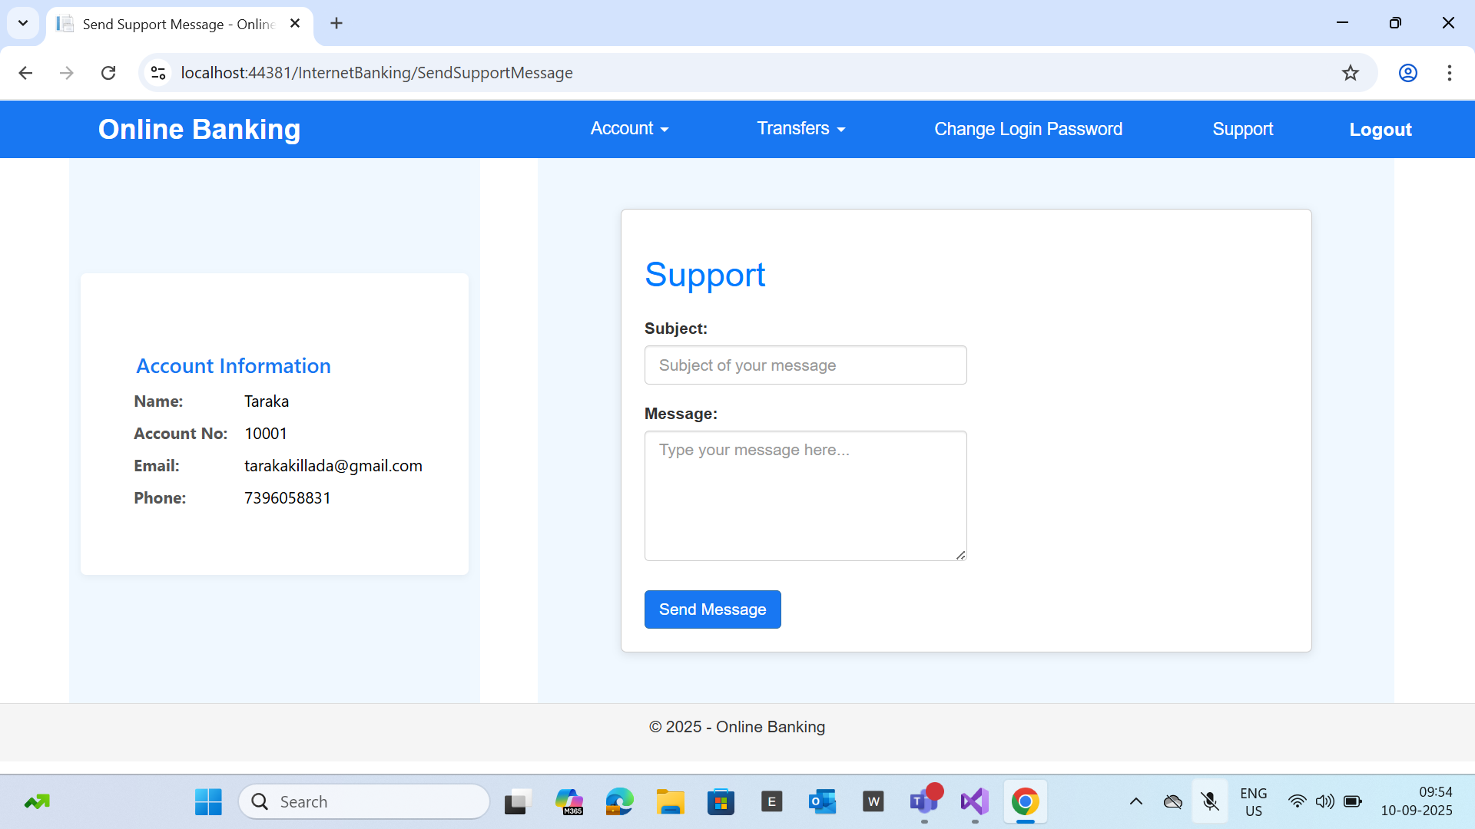

Slide 18
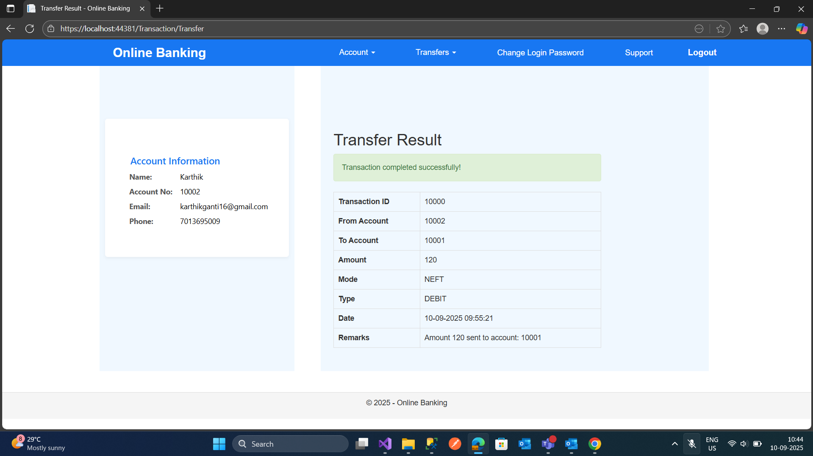

Slide 19
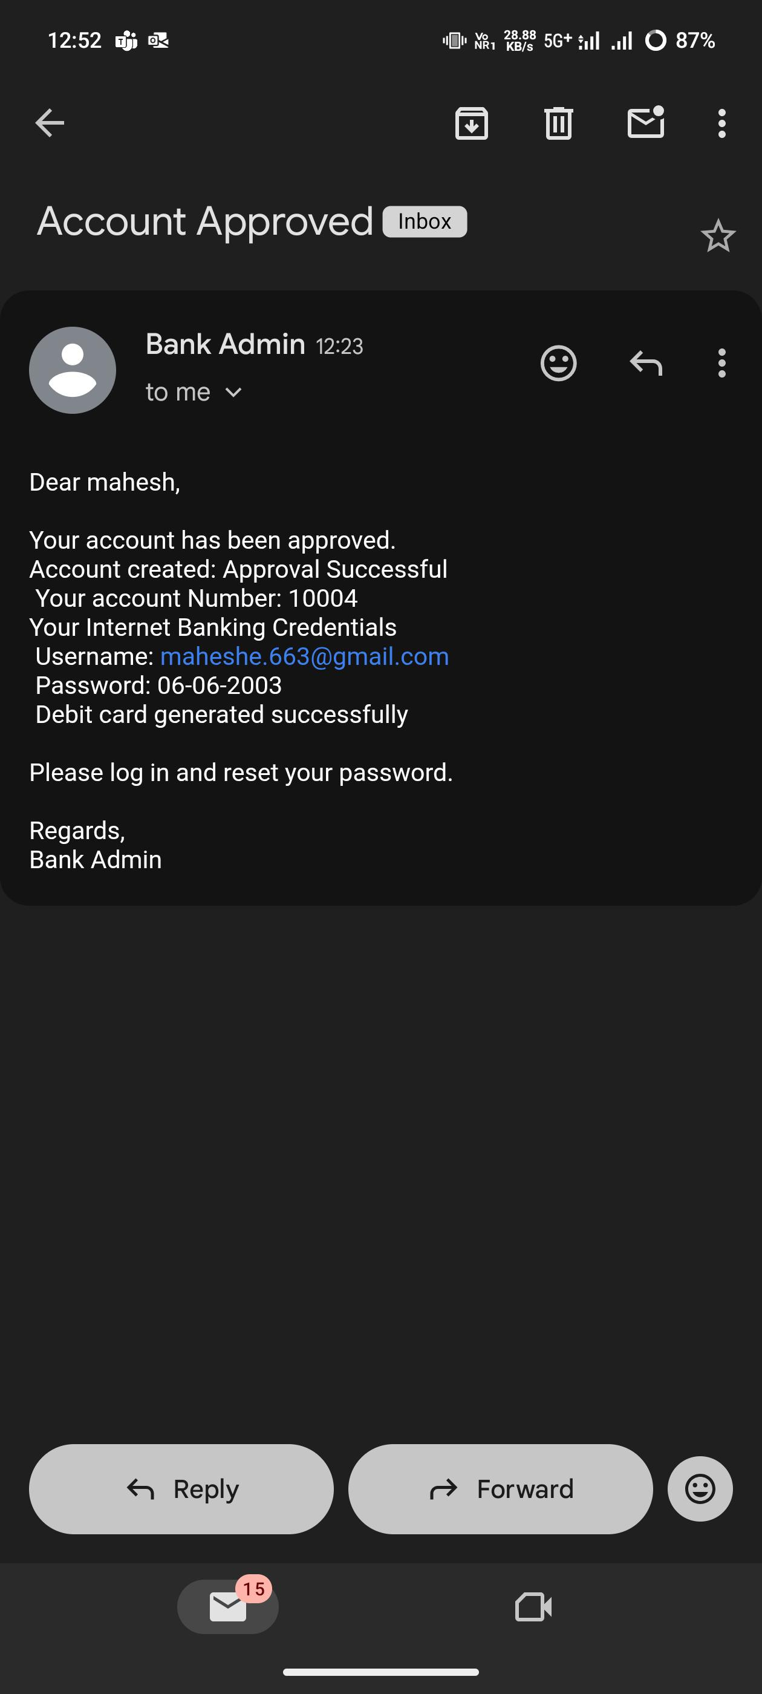
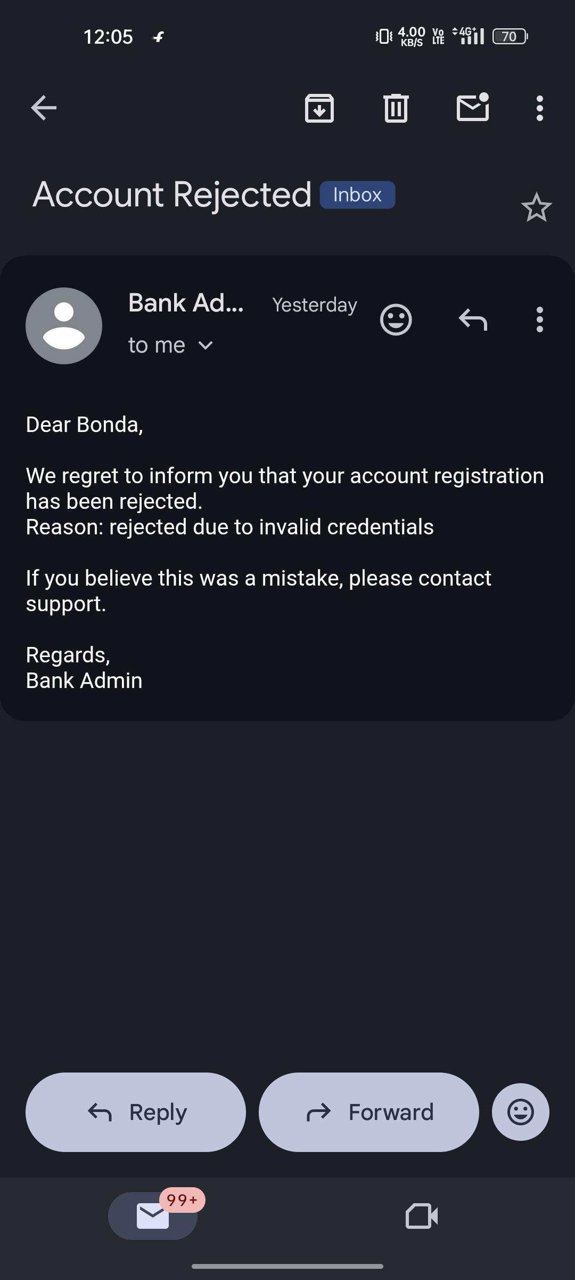
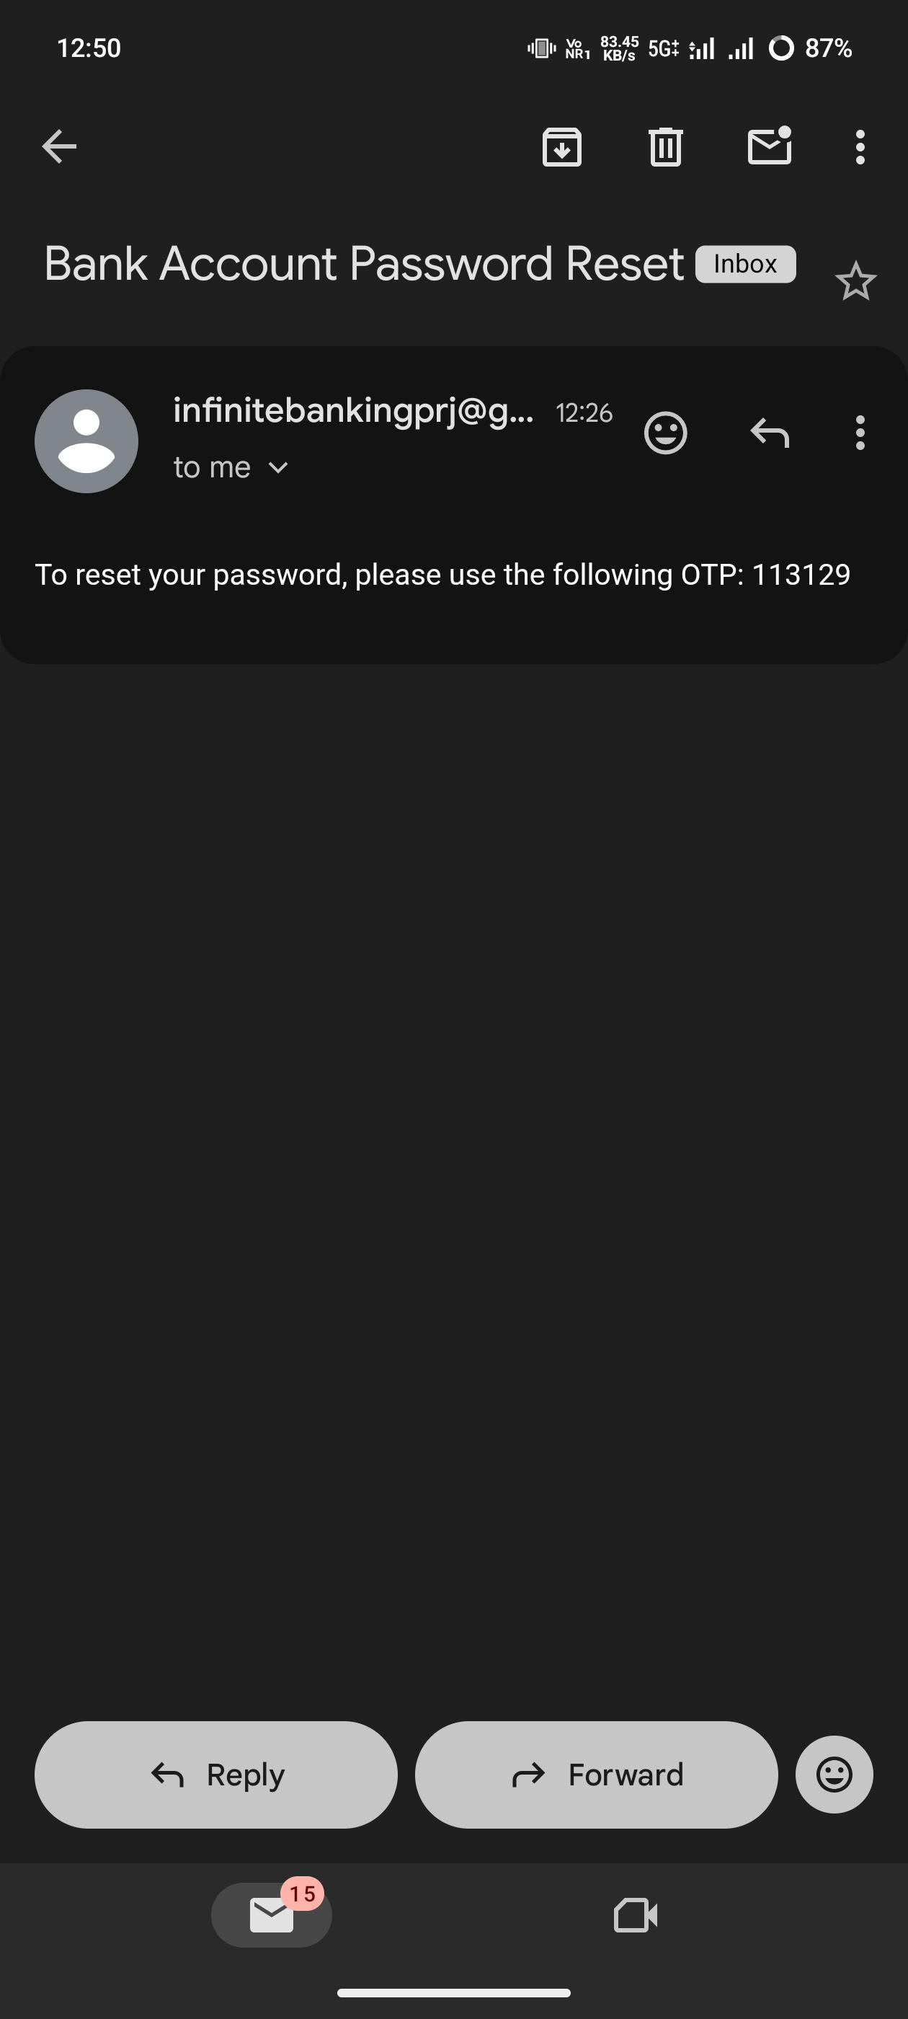
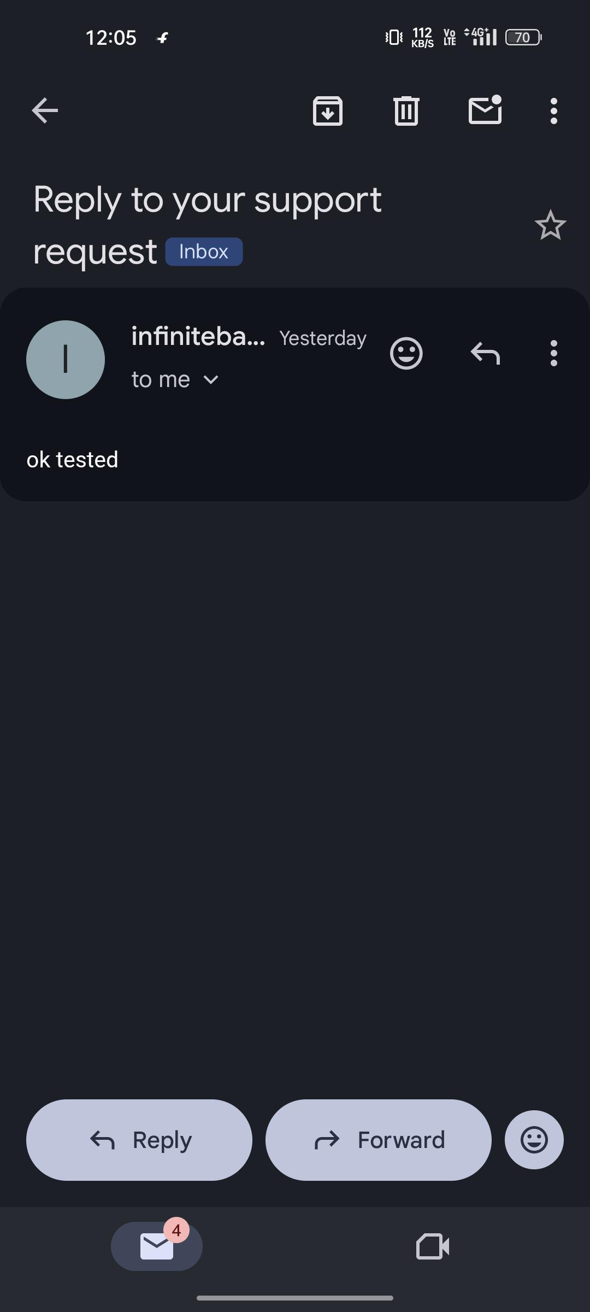

Slide 20
THANK YOU

